Slide 1
Functional Programming is Awesome
What is Functional Programming? How is it done at Solita? How to get started?

Slide 2
About me
Jukka Länsineva
3 years Solita now, 6+ years in the industry
Bachelor of Science from Oulu University
Full-stack Clojurist
With professioanl experience on Java, JS, .. And hobbyist all-around
…Mostly Clojure
BJJ/Judoka, video & board gamer, drony & bleepy musician (whatever keeps me from my Master’s)

Slide 3
How I got started
Like many, I got into programming by writing games
…so like many, I got started with imperative programming
C / C++ / C# and the like
Got into FP later with web stuff

Slide 4
What’s programming?
Computation to achieve some result
1 + 2 + 3 => 6, db -> web-server => client-html, game-state -> game-logic => frame on screen
Two ways to go about it
Imperative (e.g. Object-oriented)
Declarative (e.g. Functional)
Based on models of Turing Machines and Lambda Calculus respectively

Slide 5
Turing Machines
Model of computation that works by doing operations on a state to achieve a result
Imperative systems are based on this
Can be used to model a CPU, programming languages, algorithms…
Turing completeness means some system can implement a turing machine
Also in fun places: Minecraft, Dwarf Fortress, Factorio, Magic the Gathering are Turing Complete

Slide 6
Lambda Calculus
A notation system for computation by Alonzo Church
Simple and elegant system with just three things in it
Symbols, to present values
Abstractions, to present function definitions
Applications, to function application to parameters
With this, you can compute everything
Also, equivalent to Turing Machines, so what can be done in Turing Complete language, can be done via Lambda Calculus
So it really does everything

Slide 7
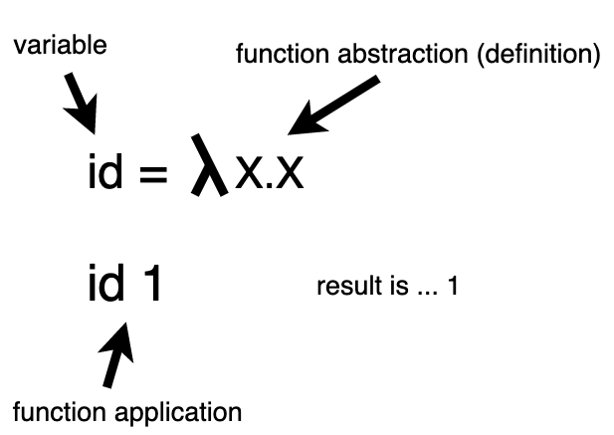
Lambda Operations

Slide 8
It’s fine!
You don’t have to really know this stuff to work a programming career
It helps though for deeper enlightement
It’s good to have awareness of these models that lay the fundamentals of our work
The key takeaway is that the two models are equivalent i.e. you can get same results via both imperative and functional approaches
But if you want to know more … https://www.youtube.com/watch?v=3VQ382QG-y4

Slide 9
So what is FP?
FP is basically implementation of Lambda Calculus, it just has more stuff defined for ease of use
But don’t all programming languages have functions? What’s the big deal?
In FP we talk about functions in the mathematical sense, rather than functions in programming sense i.e. methods
Function maps some input to an output
Historically popular in Academia for obvious reasons, seen rise in industry (like in financial sector)
Lisp, Haskell, Erlang, Ocaml, Elixir, F#...

Slide 10
Key FP concepts
Purity – Function’s return value is dependant on its inputs / parameters only
First-class Functions – functions can be passed to other functions as parameters
Immutability – Once a value is bound it cannot be changed
Lazy Evaluation – Order of execution does not matter
Recursion – Iteration by functions invoking themselves, no need for loops

Slide 11
FP vs OOP
The what
I want a Mexicana
Data goes through a series of transformative operations in a forward moving flow
Dough -> add-pepperoni -> add-jalapenos … -> pizza
…we can still access the dough
The what
I want a pizza, put on dough pepperoni, jalapenos, pineapple and mexicana sauce
Data is operated on by code in place, in reverse way than FP
Dough <- add-pepperoni – add-jalapenos .. = pizza
Dough becomes the pizza

Slide 12
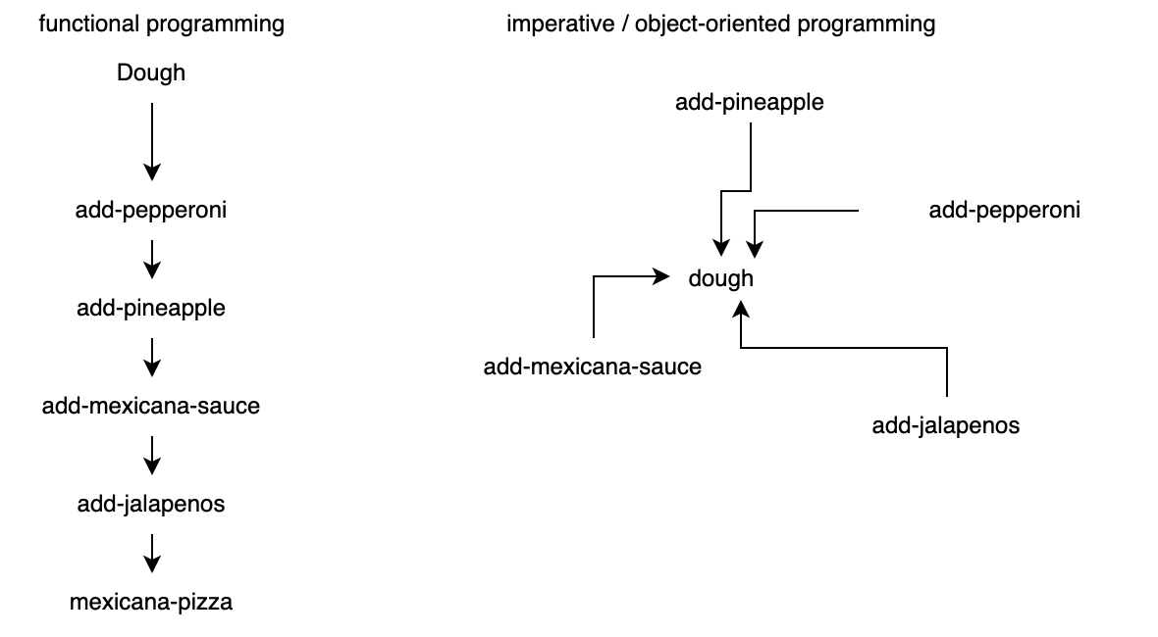
In the end we have pizza – with slightly different approaches

Slide 13
Summation of differences
Functional programming has
Immutability
Recursion
Pure functions
Lazy evaluation
Functions, symbols as building blocks
Imperative programming has
Mutability
Loops
Naturally effectual functions
Eager evaluation
Classes, data objects as building blocks

Slide 14
So which is better? It depends
Functional code tends to be more bytesized, and for that reason, more modular
Purity leads to more testable and robust code
So, in theory, less bugs (there’s always bugs!)
Mutations tend to be more performant, but can cause more bugs
Immutability is more safe, but can be more resource intensive
Computers are closer to Turing Machines (but this can be solved by a compiler)

Slide 15
FP Creeping in
Modern languages are multi-paradigm
Scala, Kotlin, Rust…
FP has also inspired many languages and frameworks
React, lambdas in Java, …

Slide 16
So what do I actually do?
In Solita we use Clojure
It’s on our Career pages
20+ projects have been done or currently use Clojure
I’m in a full-stack Clojure project called Harja
Harja is open source, so you can go make PRs

Slide 17
What is Clojure?
A Lisp variant that works on top of JVM (Java Virtual Machine)
So it runs everywhere Java runs
JVM Is very well battletested technology
Can interop with Java libraries and other JVM Technologies
Massive ecosystem
…though of course, there’s danger in vulns like Log4J2

Slide 18
Clojure is Full-Stack
Clojure + ClojureScript
ClojureScript is Clojure that transpiles to JavaScript
So you can interop with JavaScript
With Clojure + ClojureScript you can write code once, use everywhere
Good for example utility functions that should be the same on both ends of stack

Slide 19
The original presentation is in Clojure
http://www.github.com/jlansineva/slidet-oamk

Slide 20
Examples.clj has some example code
Run with Leiningen!

Slide 21
REPL rocks
REPL stands for Read-Eval-Print-Loop and is the Killer App for development
Allows you write and evaluate code at runtime
Test your code in the real context of the application, safely.
Expand the code of your application dynamically
It’s pretty cool and fast

Slide 22
Writing web in Clojure
Check the talk for the API expansion (I’ll write some steps to the repo)
Check Harja for a real app for context

Slide 23
What makes Clojure so great?
REPL makes development smooth
Fast feedback loop and easy experimentation
Writing new experimental code is easy and mostly safe
Writing functional code has a natural flow to it
Due to working with data structures. In Clojure, code is data, as we like to say
It’s actually data, Clojure code is just lot of lists
The code has beauty to it due to its small and modular nature
Sure, it can be hard to get into at first
Clojure itself, is actually in large parts written with Clojure

Slide 24
Clojure in Finland
Solita, Metosin, Gofore, Siili, Vincit, Yle, …
Among others

Slide 25
FP can make you a better programmer
You can utilize functional concepts
Immutability can be good idea, if performance allows
Writing small functions is preferrable
Embrace purity to make your code easy to test
Keep any possible effects contained as much as possible

Slide 26
How to get into Clojure
Clojure for the Brave and True – the free ebook
https://www.braveclojure.com/clojure-for-the-brave-and-true/
4Clojure – Clojure exercises online
https://4clojure.oxal.org
TryClojure – more exercises
https://tryclojure.org/
Clojure Koans – more small exercises
https://github.com/functional-koans/clojure-koans
Get Leiningen and start hacking – http://www.leiningen.org
Get the slides app at https://github.com/jlansineva/slidet-oamk

Slide 27
Thanks!
Hit me up at
LinkedIn https://www.linkedin.com/in/jukkalansineva/
E-mail jukka.lansineva@solita.fi
GitHub http://www.github.com/jlansineva
Check Solita careers at
http://www.solita.fi/careers

